Slide 1
EAX TSP
Yuichi Nagata, Shigenobu Kobayashi

Slide 2
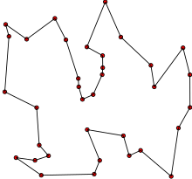
The Tsp problem
NP hard combinatorial optimization problem
It is a permutation problem
The goal is to find the shortest route, while visiting all cities exactly ones
The edges can be both weighted or not

Slide 3
Previous work on this task
The Lin–Kernighan (LK) algorithm and its extensions
Hybrid genetic algorithms (memetic algorithms)
Genetic local search algorithms
Development of different crossover operators, specifically for this problem
The current state-of-the-art exact algorithm “Concorde”

Slide 4
Key ideas and outline

Slide 5
Framework
Generate Npop solutions by a specific procedure so that they are all with a required level of quality
In each generation, each of the members is picked one as Pa and once as Pb
They produce Nchild number of children
The best one from the offspring and Pa is chosen, and it replaces Pa (Thus we have to note that no change occurs when the whole offspring is with worse quality that Pa itself)
This procedure continues until a termination condition is met
The best solution is returned

Slide 6
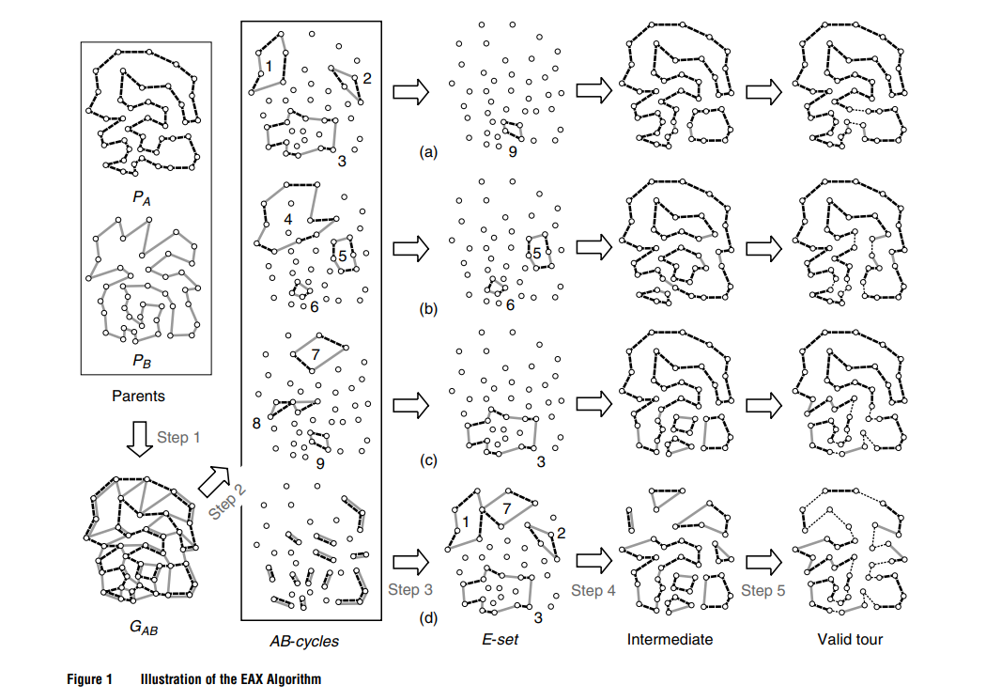
The EAX algorithm
Create a multigraph Gab, consisting of the all the edges of both parent
Create AB-cycles (cycles, in which the edges from Pa and Pb are alternately linked)
. Construct an E-set by selecting AB-cycles according to a given selection strategy,

Slide 7
The EAX algorithm
Generate the an intermediate solutions based on on this rule
Connect all the subtours into a tour
Check if you need to create another offspring solution, if not-terminate

Slide 8
Selecting AB-cycles
Random strategy
Randomly with a 0.5 probability
Selection strategy
Randomly, but with no overlap with previous selections
K-multiple strategy
Select K random cycles where K is a parameter
Block2 strategy
Heuristic selection strategy which aims to construct few, but big subtours

Slide 9
Configurations
Version of EAX in stages I and II
single strategy, block2 strategy, fivemultiple
Selection method of offspring solutions:
entropypreserving selection (default), greedy selection and distance-preserving selection are used.
Population size
(Npop): 300 (default). Alternatively, set to 600 if greedy selection is used.
Number of offspring solutions (Nch)
30 (default). Alternatively, set to 5, 10, and 100.

Slide 10
Computational Experiments
The proposed GA was tested on 57 instances with up to 85,900 cities
The proposed GA was implemented in C++
The proposed GA is compared to LKH-2, which is known as one of the most powerful heuristic algorithms for the TSP
GA-EAX found five new best solutions
Solution quality of GA-EAX is better than that of LKH-2 in most instances
Computation time of GA-EAX is basically smaller than that of LKH-2

